Slide 1

continuous Integration:-
JENKINS

Slide 2
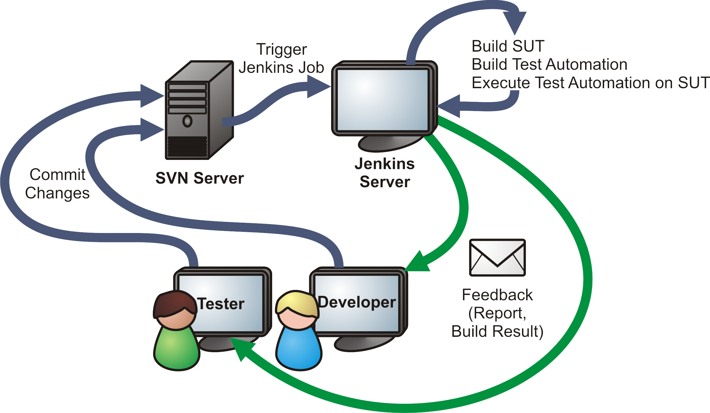
Why CI

Slide 3
What is Jenkins?
Jenkins is an application that monitors executions of repeated jobs. Jenkins focuses on:
Building/testing software projects continuously
Monitoring executions of externally-run jobs

Slide 4

Why Jenkins??
Open source
Easy installation
Easy configuration
Change set support
Permanent
RSS/E-mail/IM
JUnit/TestNG test reporting
Distributed builds
File fingerprinting
Plugin Support
Notes:
@Find
Page Factory

Slide 5
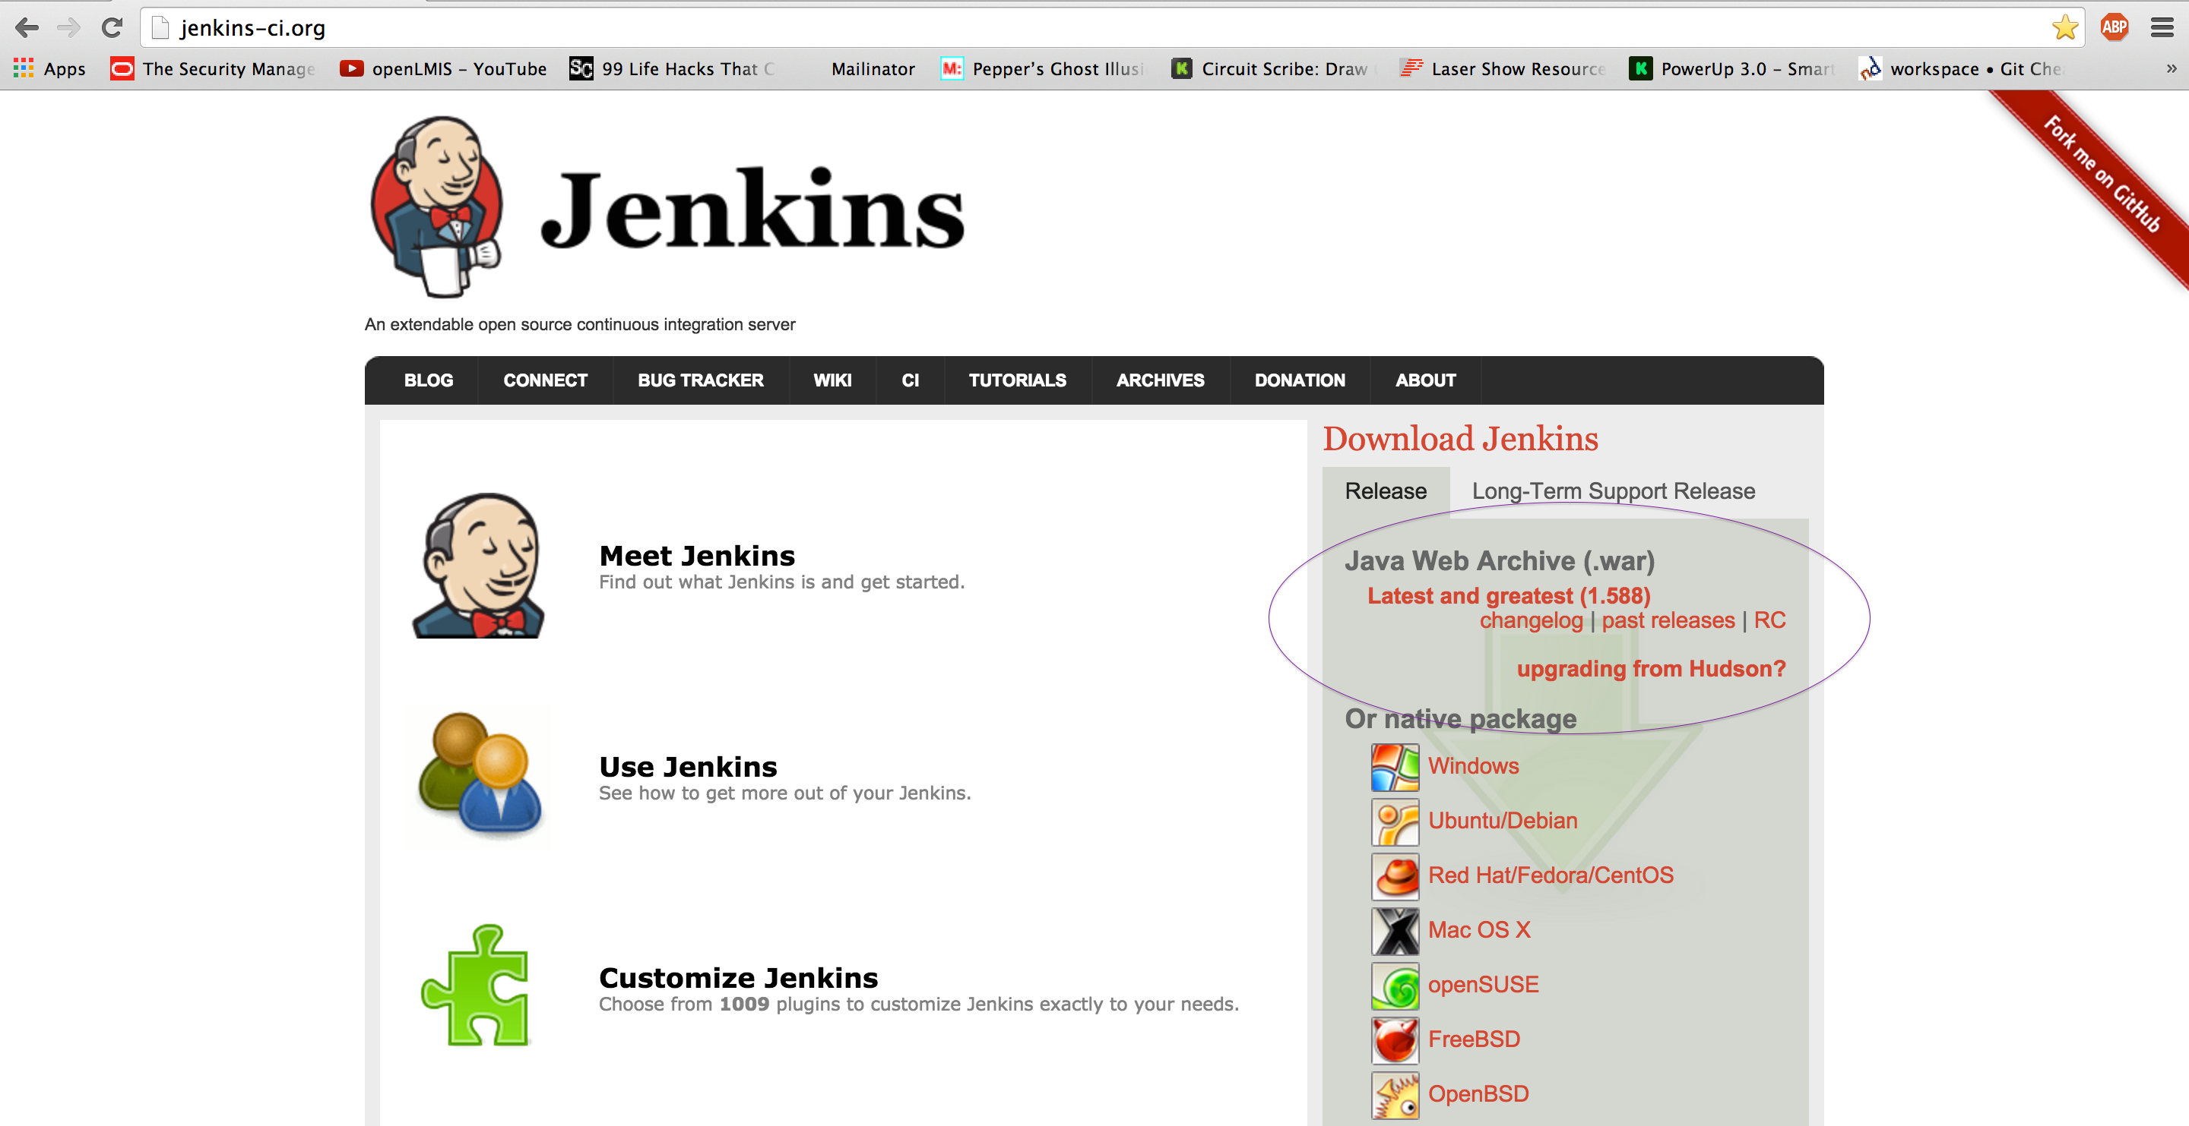
Set Up Jenkins
install jenkins.war
Notes:
Build Tool – maven, Gradle, Ant
CI – jenkins, Go, Hudson, Cruise Control
BDD – Cucumber, JBehave

Slide 6
Set Up Jenkins
open cmd with run as admin
run java -jar jenkins.war
But first check if Java is present, if not then install JDK7
Notes:
Build Tool – maven, Gradle, Ant
CI – jenkins, Go, Hudson, Cruise Control
BDD – Cucumber, JBehave

Slide 7
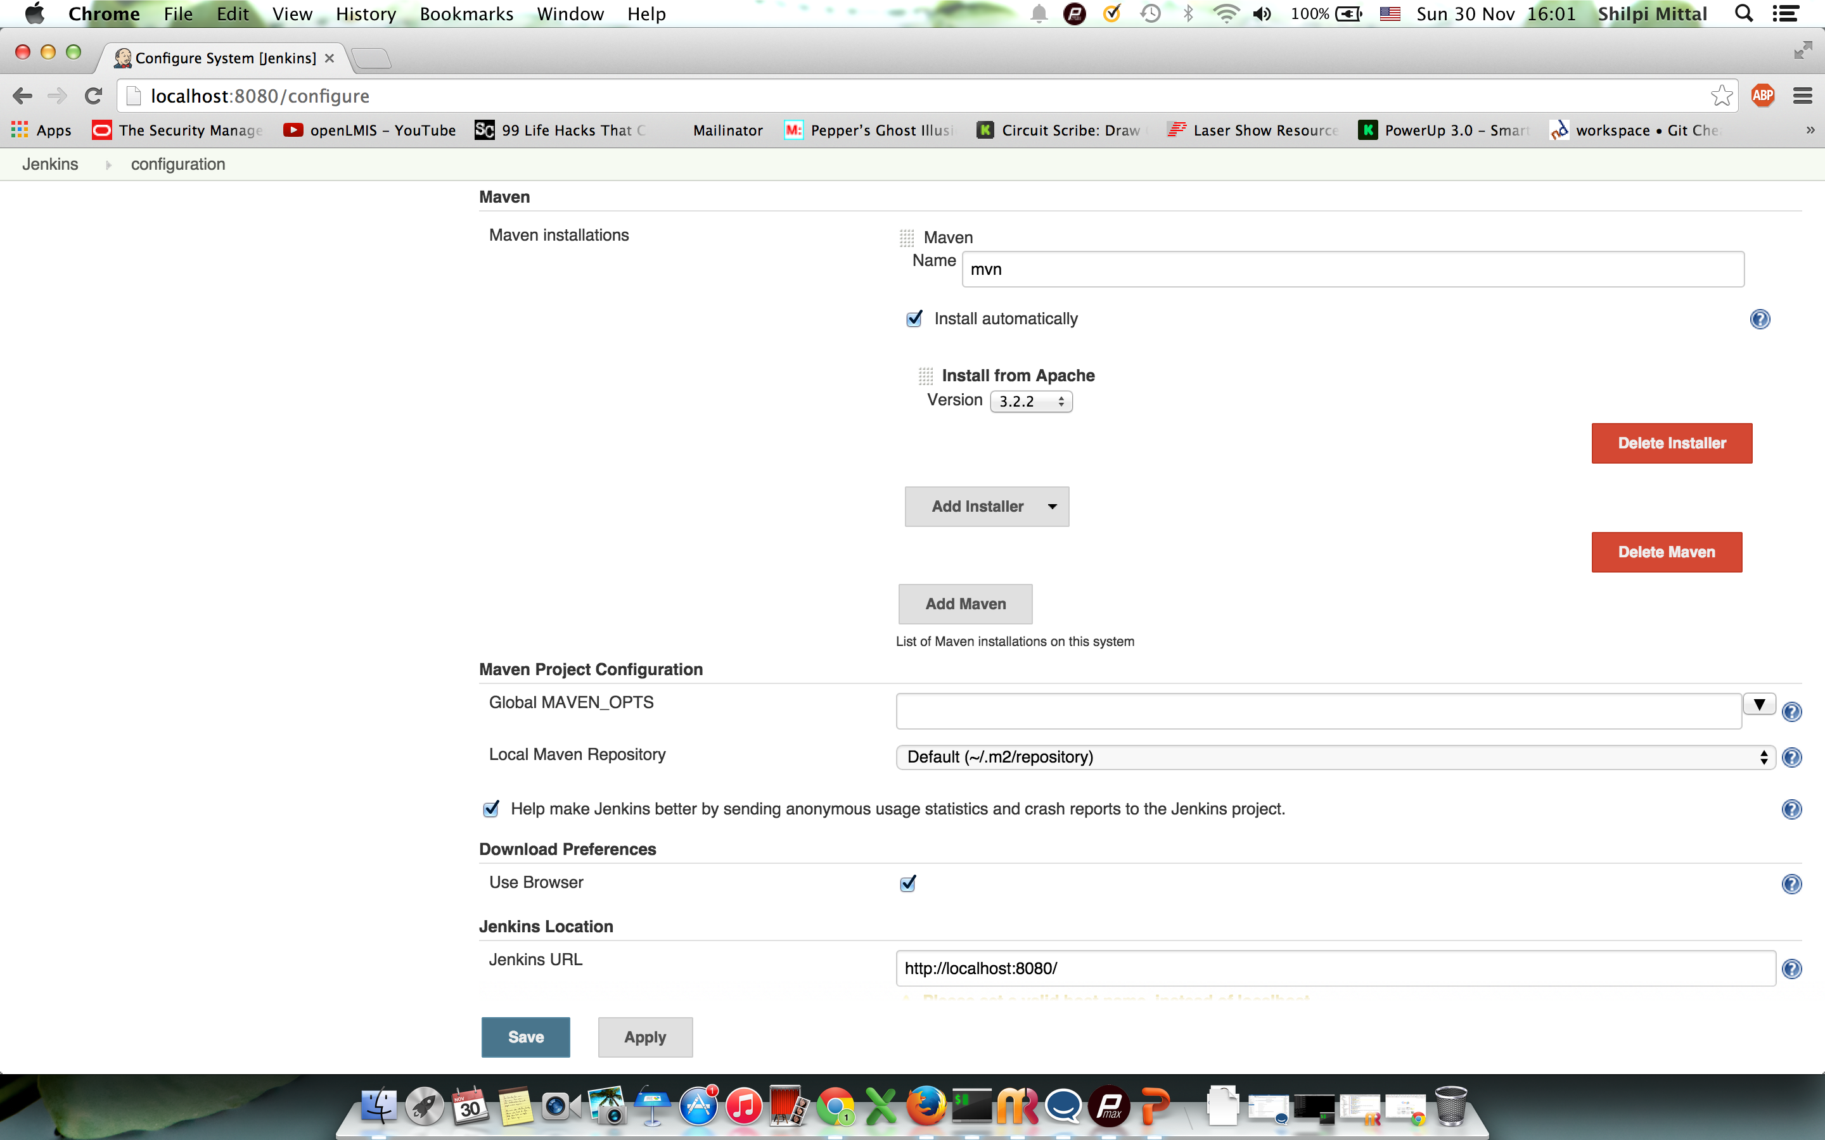
Maven With Jenkins
Notes:
Build Tool – maven, Gradle, Ant
CI – jenkins, Go, Hudson, Cruise Control
BDD – Cucumber, JBehave

Slide 8
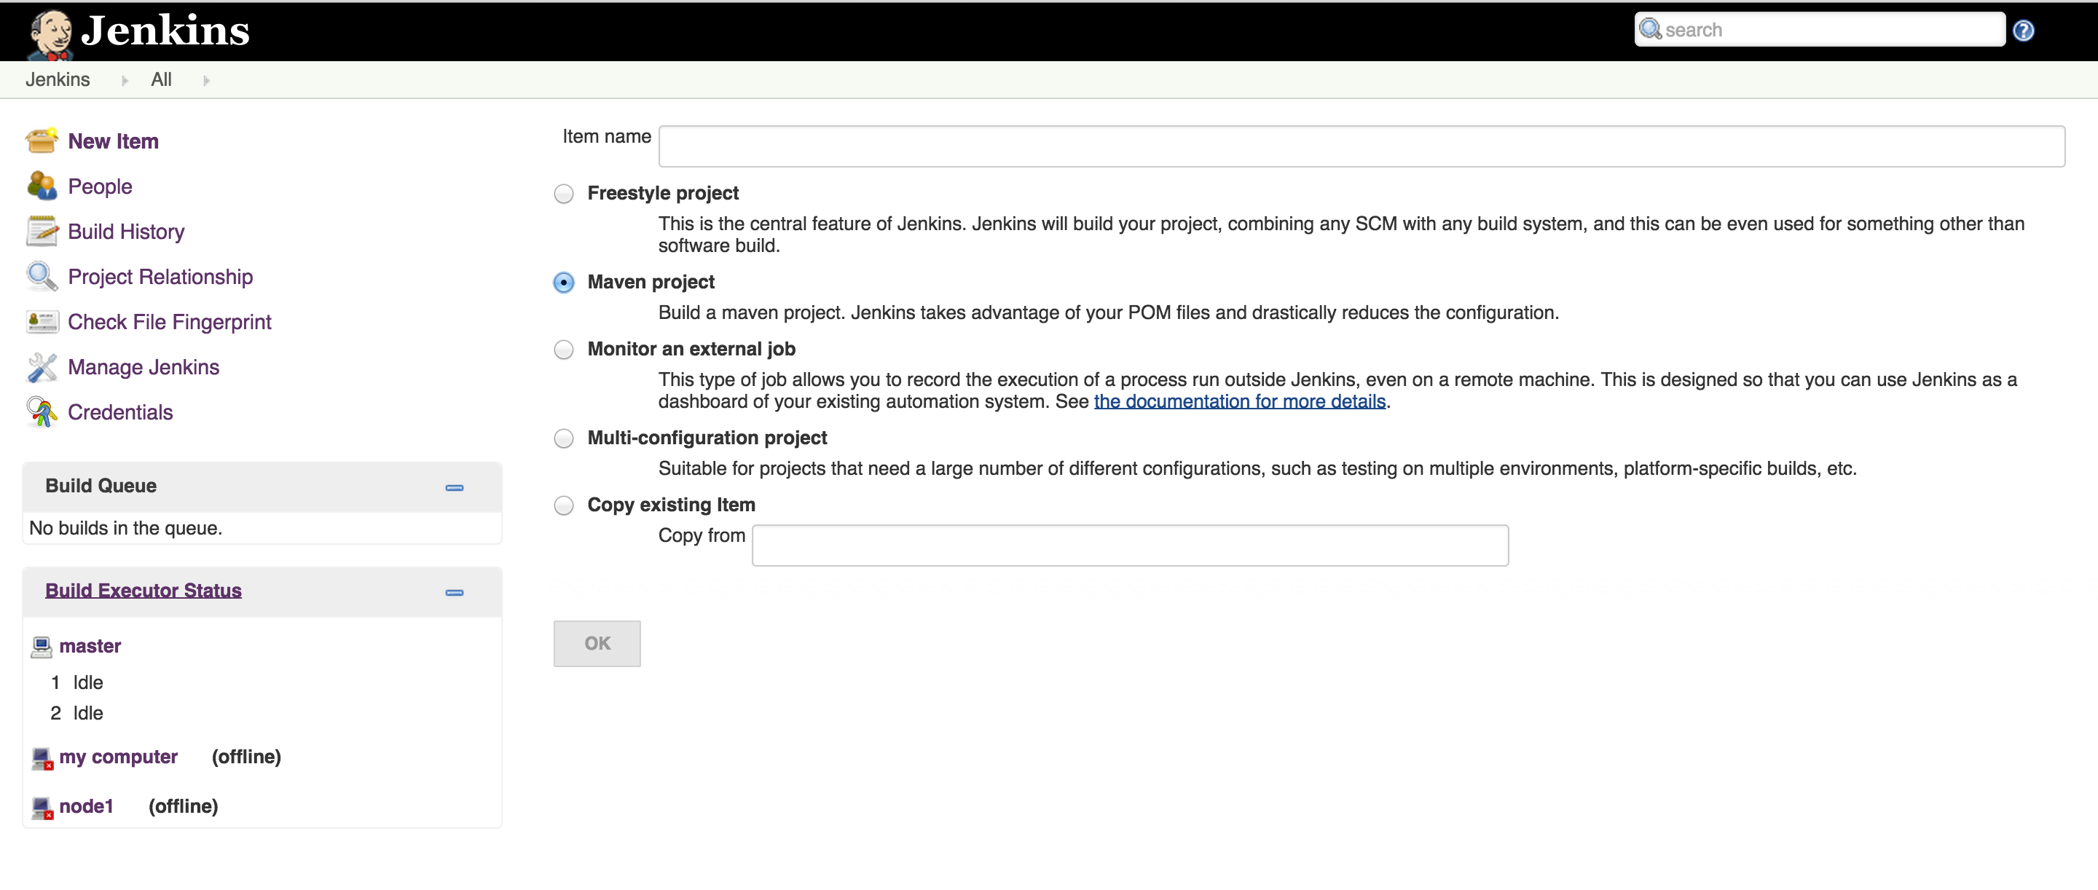
Creating a Job
Choose Maven project
Enter name and click create
Notes:
Build Tool – maven, Gradle, Ant
CI – jenkins, Go, Hudson, Cruise Control
BDD – Cucumber, JBehave

Slide 9
Give project path

Slide 10
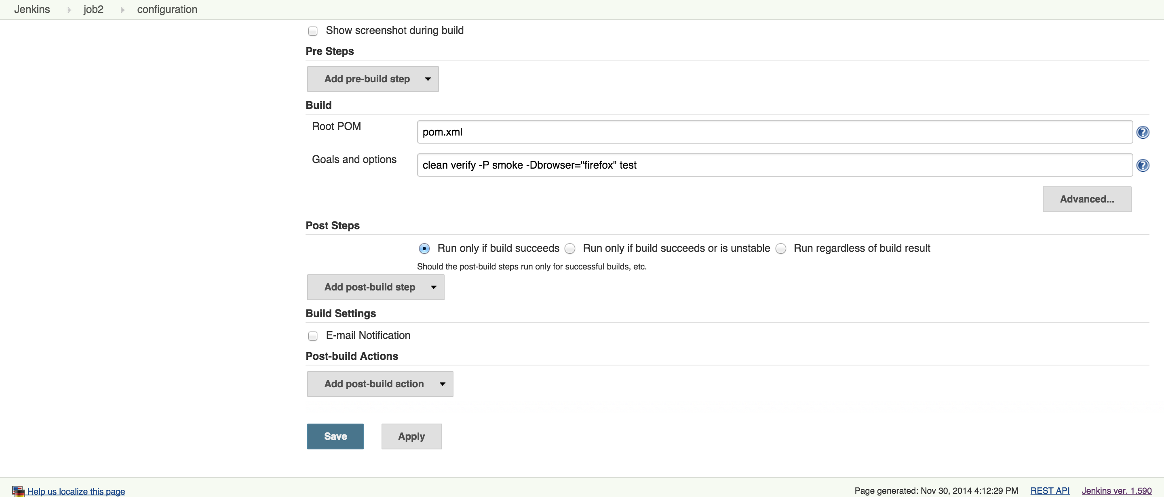
Specify Maven goal
Notes:
Build Tool – maven, Gradle, Ant
CI – jenkins, Go, Hudson, Cruise Control
BDD – Cucumber, JBehave

Slide 11
Reporting
TestNG reports plugin
Notes:
Build Tool – maven, Gradle, Ant
CI – jenkins, Go, Hudson, Cruise Control
BDD – Cucumber, JBehave

Slide 12
Email notification

Slide 13
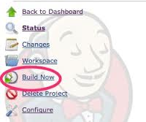
And We’re ready to go!!!
Notes:
Build Tool – maven, Gradle, Ant
CI – jenkins, Go, Hudson, Cruise Control
BDD – Cucumber, JBehave

Slide 14
Giving project git path to the job
Go to manage plugins and install plugin
Now give path, see the error
Install Git and Go to Configure Jenkins and mention path to git.exe
Notes:
Build Tool – maven, Gradle, Ant
CI – jenkins, Go, Hudson, Cruise Control
BDD – Cucumber, JBehave

Slide 15
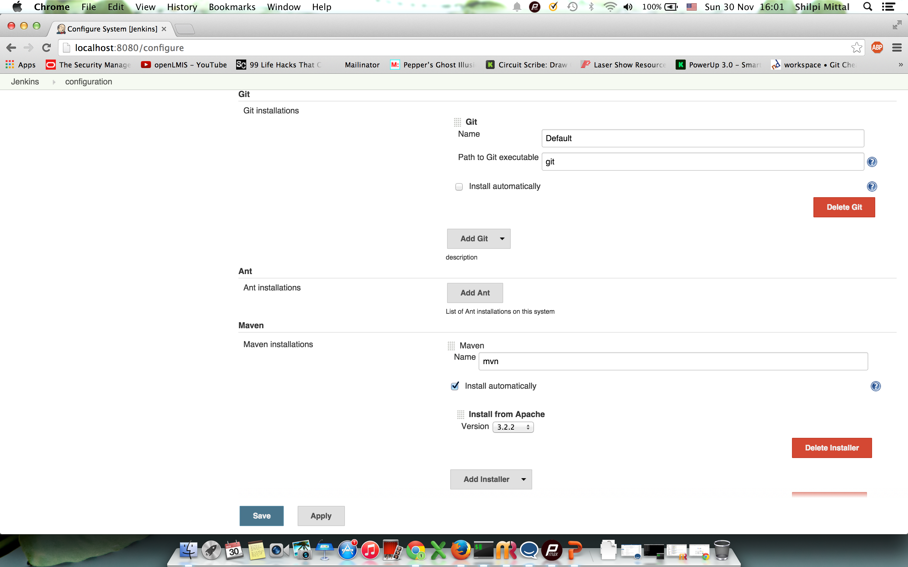
Notes:
Build Tool – maven, Gradle, Ant
CI – jenkins, Go, Hudson, Cruise Control
BDD – Cucumber, JBehave

Slide 16

Questions

